Slide 1

Experiment 1:
Group1: Nrf2-/-, AIN93M (N=9)
Group2: Nrf2-/-, PEITC (N=9)
Experiment 2:
Group3: WT, AIN93M (N=5)
Group4: WT, PEITC (N=5)
Experiment 3:
Group5: WT, AIN93M (N=5)
Group6: WT, AIN93M, DSS (N=5)
Group7: WT, Cranberry, DSS (N=5)
Group8: WT, PEITC, DSS (N=5)
Group9: Nrf2-/-, AIN93M (N=5)
Group10: Nrf2-/-, AIN93M, DSS (N=5)
Group11: Nrf2-/-, Cranberry, DSS (N=5)
Group12: Nrf2-/-, PEITC, DSS (N=5)
AIN93M : Groups 1, 3, 5, 6, 9 and 10
AIN93M: Groups 2, 4,
7, 8, 11 and 12
AIN93M + 0.05% PEITC Groups 2, 4,8 and 12
AIN93M + Cranberry: Groups 7 and 11
X
X
X
X
X
X
Week 0 1 2 4 5 6 8
Gut microbiota equalization period (2 weeks)
Figure 1: Experimental design. Mice fecal samples for the 16S sequencing were collected individually at 3 timepoints – at the end of the 2-week equalization period (Week 0), at an early timepoint (Week 1) and at a late timepoint (Week 4 or Week 8). Samples used for metabolite analysis were collected at an early and a late timepoints (Weeks 2 and Week 6 respectively).
Notes:
Figure 1: Experimental design. Mice fecal samples for the 16S sequencing were collected individually at 3 timepoints – at the end of the 2-week equalization period (Week 0), at an early timepoint (Week 1) and at a late timepoint (Week 4 or Week 8). Samples used for metabolite analysis were collected at an early and a late timepoints (Weeks 2 and Week 6 respectively).
Experiment 1 (Exp01) = Nov18
Experiment 2 (Exp02) = May19
Experiment 3 (Exp03) = Sep19

Slide 2
Supplemental Figure 1: 16S sequencing depth (total number of hits per sample).
Notes:
Supplemental Figure 1: 16S sequencing depth (total number of hits per sample).

Slide 3
A
B
Figure 2: Alpha diversity measured by Shannon index. (A) Averages of Shannon indices calculated on raw OTU numbers and (B) on corrected OUT numbers (OTU+1).
Notes:
Figure 2: Alpha diversity measured by Shannon index. (A) Averages of Shannon indices calculated on raw OTU numbers and (B) on corrected OUT numbers (OTU+1).

Slide 4
A
B
Supplemental Figure 2: Shannon index vs. sequencing depth.
Notes:
Supplemental Figure 2: Shannon index vs. sequencing depth.

Slide 5
Supplemental Figure 3: logit of the relative abundance of Phylum vs. sequencing depth
Notes:
Supplemental Figure 3: logit of the relative abundance of Phylum vs. sequencing depth

Slide 6
Figure 4: Biplot of logit relative abundance of Phylum
Notes:
Figure 4: Biplot of logit relative abundance of Phylum

Slide 7
Figure 5: biplot of logit relative abundance of Phylum in Exp03 only
Notes:
Figure 5: biplot of logit relative abundance of Phylum in Exp03 only

Slide 8
Figure 6: Biplot of logit relative abundance of Classes
Notes:
Figure 6: Biplot of logit relative abundance of Classes

Slide 9
Figure 7: biplot of logit relative abundance of Classes in Exp03 only
Notes:
Figure 7: biplot of logit relative abundance of Classes in Exp03 only

Slide 10
Figure 8: Means of log2 F/B ratios by genotype and diet over time. The bars represent standard errors of log2(F/B) ratios.
Notes:
Figure 8: Means of log2 F/B ratios by genotype and diet over time. The bars represent standard errors of log2(F/B) ratios.

Slide 11
Figure 9: Linear discriminant analysis Effect Size (LEfSe) analysis of aging effect.
Notes:
Figure 9: Linear discriminant analysis Effect Size (LEfSe) analysis of aging effect.

Slide 12
Figure 10: Linear discriminant analysis Effect Size (LEfSe) analysis of diet effect.
Notes:
Figure 10: Linear discriminant analysis Effect Size (LEfSe) analysis of diet effect.

Slide 13
A
B
Figure 11: Biplots of amino acids by diet (A) and bile acids by genotype (B) .
Notes:
Figure 11: Biplots of amino acids by diet (A) and bile acids by genotype (B) .

Slide 14
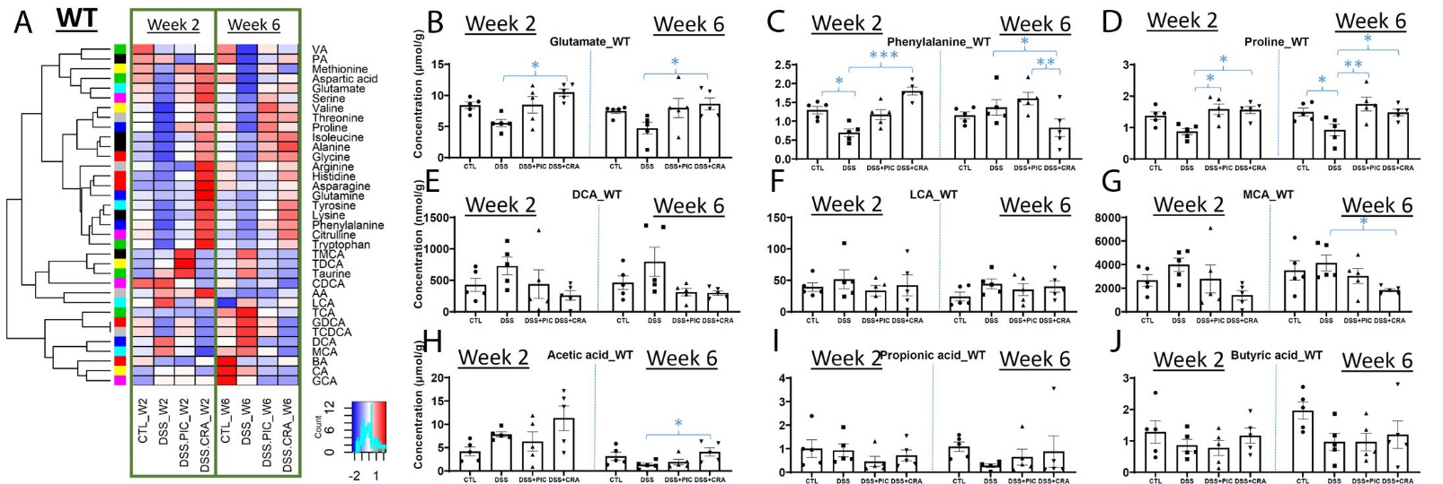
Figure 12: Effects of DSS, PEITC and cranberry cotreatments on fecal metabolome of WT mice. Fecal samples collected at week 2 and 6 of 4 treatments, including control (CTL), DSS, DSS+PEITC (DSS+PIC), and DSS+cranberry (DSS+CRA), were analyzed by 4 LC-MS methods (143). The concentrations of amino acids, bile acids, and SCFA were quantified. (A) A heatmap on the distribution of amino acids, bile acids and SCFA in fecal samples from 4 treatments. (B-D) Concentrations of major amino acids, including glutamate, phenylalanine, and proline. (E-G) Concentrations of major bile acids, including DCA, LCA, and MCA. (H-J) Concentrations of major SCFA, including acetic acid (AA), propionic acid (PA), and butyric acid (BA).
Notes:
Figure 12: Effects of DSS, PEITC and cranberry cotreatments on fecal metabolome of WT mice. Fecal samples collected at week 2 and 6 of 4 treatments, including control (CTL), DSS, DSS+PEITC (DSS+PIC), and DSS+cranberry (DSS+CRA), were analyzed by 4 LC-MS methods (143). The concentrations of amino acids, bile acids, and SCFA were quantified. (A) A heatmap on the distribution of amino acids, bile acids and SCFA in fecal samples from 4 treatments. (B-D) Concentrations of major amino acids, including glutamate, phenylalanine, and proline. (E-G) Concentrations of major bile acids, including DCA, LCA, and MCA. (H-J) Concentrations of major SCFA, including acetic acid (AA), propionic acid (PA), and butyric acid (BA).

Slide 15
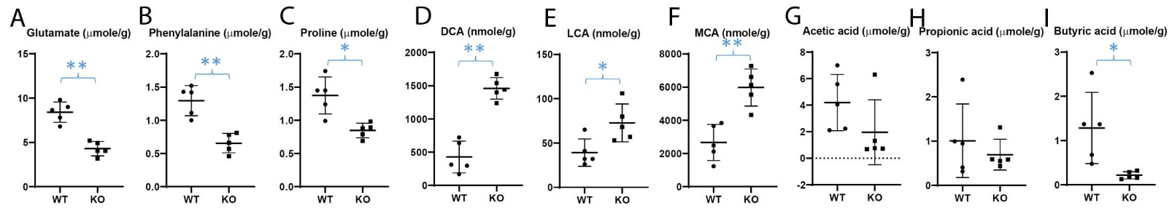
Figure 13: Differences in fecal metabolite profile between WT and Nrf2-null (KO) mice. The concentrations of amino acids, bile acids, and SCFA were quantified in the fecal samples from untreated WT and KO mice (143). (A-C) Concentrations of glutamate, phenylalanine, and proline. (D-F) Concentrations of major bile acids. (G-I) Concentrations of major SCFA.
Notes:
Figure 13: Differences in fecal metabolite profile between WT and Nrf2-null (KO) mice. The concentrations of amino acids, bile acids, and SCFA were quantified in the fecal samples from untreated WT and KO mice (143). (A-C) Concentrations of glutamate, phenylalanine, and proline. (D-F) Concentrations of major bile acids. (G-I) Concentrations of major SCFA.

Slide 16
Forward Primer | Reverse Primer
515F (Parada) | 806R (Apprill)
GTGYCAGCMGCCGCGGTAA | GGACTACNVGGGTWTCTAAT
Supplemental Table 1: V4 primer sequence used for 16s RNA sequencing library preparation
Notes:
Supplemental Table 1: V4 primer sequence used for 16s RNA sequencing library preparation

Slide 17
Kingdom | Experiment 1: Nrf2 KO Mice | Experiment 2: WT Mice | Experiment 3: WT and Nrf2 KO | Combined
Bacteria | 10,197 (94.78%) | 7,994 (98.34%) | 7,558 (96.07%) | 22,251 (95.73%)
Eukaryota | 472 (4.39%) | 116 (1.43%) | 232 (2.95%) | 812 (3.49%)
Archaea | 4 (0.04%) | 0 (0%) | 2 (0.03%) | 6 (0.03%)
Unknown | 86 (0.80%) | 19 (0.23%) | 75 (0.95%) | 175 (0.75%)
Table 1: OTUs mapping to Kingdoms. Number of OTU (% total)
Notes:
Table 1: OTUs mapping to Kingdoms. Number of OTU (% total)

Slide 18
Table 2: multinomial regression predictions of treatment groups by microbial metabolite PCA
Notes:
Table 2: multinomial regression predictions of treatment groups by microbial metabolite PCA

Slide 19
Table 3: multinomial regression predictions of genotype by microbial metabolite PCA
Notes:
Table 3: multinomial regression predictions of genotype by microbial metabolite PCA

